Slide 1
COMPUTER NETWORKS
THE DATALINK LAYER

Slide 2
Chapter 3: Data Link layer
our goals:
understand principles behind link layer services:
framing
error detection, correction
sharing a broadcast channel: multiple access
link layer addressing (MAC address)
local area networks: Ethernet, VLANs
instantiation, implementation of various link layer technologies

Slide 3

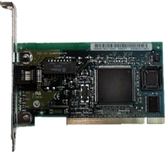
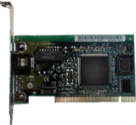
Link layer, LANs: outline
6.1 introduction, services
6.2 framing
6.3 error detection, correction
6.4 data link protocols
- stop-n-wait
- stop-n-wait ARQ
Application
Application
Presentation
Data
Presentation
Session
Session
Transport
Data
segments
Transport
Network
Data
packets
Network
Data Link
Data
frames
Data Link
Physical
Physical
10010111001011010010110101011110101

Slide 4

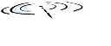




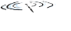







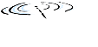


Link layer: introduction
terminology:
hosts and routers: nodes
communication channels that connect adjacent nodes along communication path: links
wired links
wireless links
LANs
layer-2 packet: frame, encapsulates datagram
data-link layer has responsibility of
transferring datagram from one node
to physically adjacent node over a link

Slide 5
Link layer: context
datagram transferred by different link protocols over different links:
e.g., Ethernet on first link, frame relay on intermediate links, 802.11 on last link
each link protocol provides different services
e.g., may or may not provide rdt over link
transportation analogy:
trip from Princeton to Lausanne
limo: Princeton to JFK
plane: JFK to Geneva
train: Geneva to Lausanne
tourists = datagram
transport segment = communication link
transportation mode = link layer protocol
travel agent = routing algorithm

Slide 6
Link layer services
framing, link access:
encapsulate datagram into frame, adding header, trailer
channel access if shared medium
“MAC” addresses used in frame headers to identify source, destination
different from IP address!
reliable delivery between adjacent nodes
we learned how to do this in chapter 3
seldom used on low bit-error link (fiber, some twisted pair)
wireless links: high error rates
Q: why both link-level and end-end reliability?

Slide 7
Link layer services (more)
flow control:
pacing between adjacent sending and receiving nodes
error detection:
errors caused by signal attenuation, noise.
receiver detects presence of errors:
signals sender for retransmission or drops frame
error correction:
receiver identifies and corrects bit error(s) without resorting to retransmission
half-duplex and full-duplex
For half-duplex, nodes at both ends of link can transmit, but not at same time
Full-duplex: both nodes can send at the same time

Slide 8
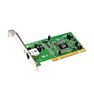
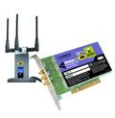

Where is the link layer implemented?
In each and every host, link layer implemented in “adaptor” (aka adapter, network interface card-NIC) or on a chip
Ethernet card, 802.11 card; Ethernet chipset
implements link, physical layer
attaches into host’s system buses
combination of hardware, software, firmware
application
transport
network
link
cpu
memory
link
physical
host
bus
(e.g., PCI)
controller
physical
transmission
network adapter
card

Slide 9
Adaptors communicating
sending host
receiving host
datagram
datagram
controller
controller
datagram
frame
Sending side
encapsulates datagram in frame
adds error checking bits, rdt, flow control, etc.
Receiving side
looks for errors, rdt, flow control, etc.
extracts datagram, passes to upper layer at receiving side

Slide 10
Link layer, LANs: outline
6.1 introduction, services
6.2 framing
6.3 error detection, correction
6.4 elementary data link protocols
- stop-n-wait
- stop-n-wait ARQ

Slide 11
Framing Methods
Byte count.
Flag bytes with byte stuffing.
Flag bytes with bit stuffing.
Physical layer coding violations.

Slide 12
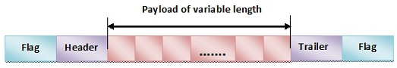
Framing Methods
Frame Header − It contains the source and the destination addresses of the frame.
Payload field − It contains the message to be delivered.
Trailer − It contains the error detection and error correction bits.
Flags − 1- byte (8-bits) flag at the beginning and at end of the frame. It is a protocol – dependent special character, signalling the start and end of the frame.

Slide 13
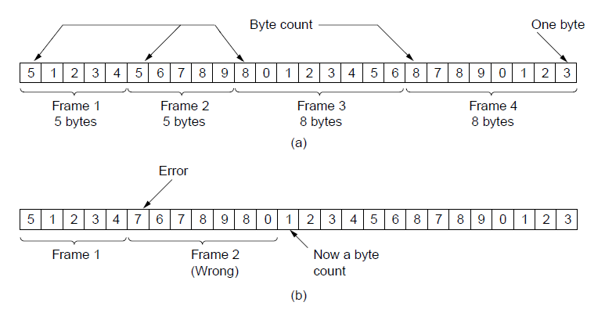
Framing (1): Byte count
Sending
A byte stream. (a) Without errors. (b) With one error.
Receiving

Slide 14
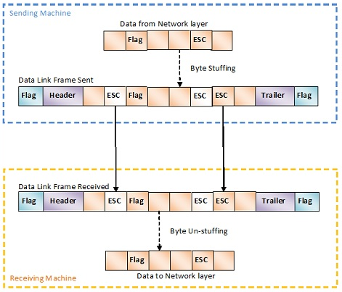
Framing (2): Flag with byte stuff
Prevent duplicate special bytes in payload message
A frame delimited (split) by flag bytes.
In byte stuffing, a special byte called the escape character (ESC) is stuffed before every byte in the message with the same pattern as the flag byte. If the ESC sequence is found in the message byte, then another ESC byte is stuffed before it.
https://www.tutorialspoint.com/what-is-byte-stuffing-in-computer-networks
ç

Slide 15
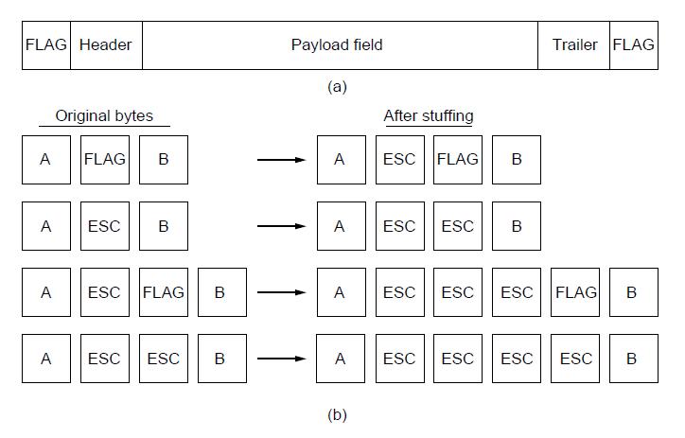
Framing (2): Flag with byte stuff
10101010
10101010
A frame delimited (split) by flag bytes.
Four examples of byte sequences before and after byte stuffing.
https://www.tutorialspoint.com/what-is-byte-stuffing-in-computer-networks

Slide 16
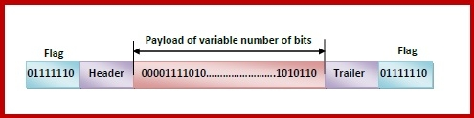
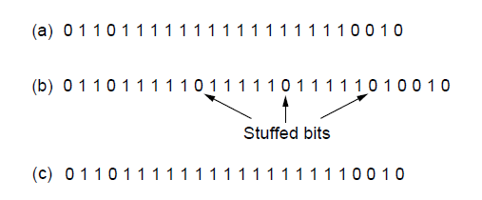
Framing (3): Flag with bit stuff
Prevent duplicate flag bit pattern in payload message
Bit stuffing. (a) The original data. (b) The data as they appear on
the line. (c) The data as they are stored in the receiver’s memory after destuffing.
Whenever a 0 bit is followed by five consecutive 1bits in the message, an extra 0 bit is stuffed at the end of the five 1s. When the receiver receives the message, it removes the stuffed 0s after each sequence of five 1s.
https://www.tutorialspoint.com/what-is-bit-stuffing-in-computer-networks

Slide 17
Framing (4): Physical layer coding violations
This method is only applicable to networks in which the encoding on the physical medium contains some redundancy.
For example, some LANs encode 1 bit of data by using 2 physical bits. Normally, a 1 bit is a high-low pair and a 0 bit is a low-high pair.
11 or 00 are not used for data but are used for delimiting (splitting) frames in some protocols.

Slide 18
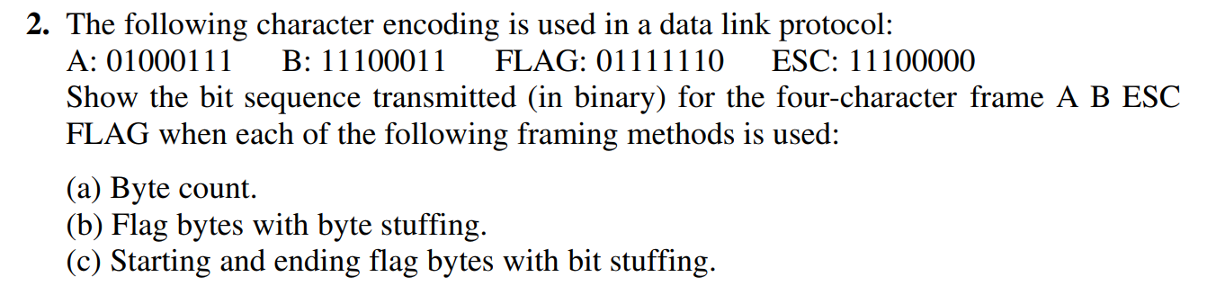
Exercise
Computer networks, Chapter 3, p.252
Exercise 2
Exercise 6

Slide 19
Link layer, LANs: outline
6.1 introduction, services
6.2 framing
6.3 error detection, correction
6.4 elementary data link protocols

Slide 20
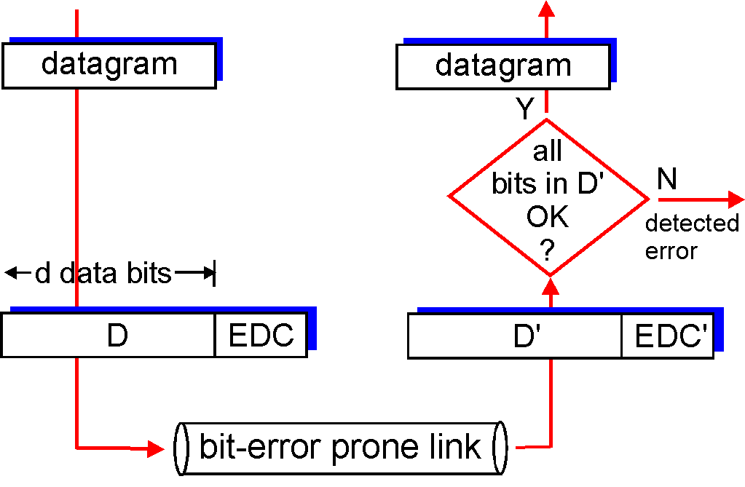
Error detection
EDC: Error Detection and Correction bits (redundancy)
D : Data protected by error checking, may include header fields
Error detection not 100% reliable!
protocol may miss some errors, but rarely
larger EDC field yields better detection and correction
otherwise

Slide 21
Error detection
Parity check
Internet checksum
Cyclic redundancy check (CRC)

Slide 22
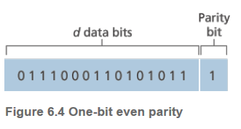
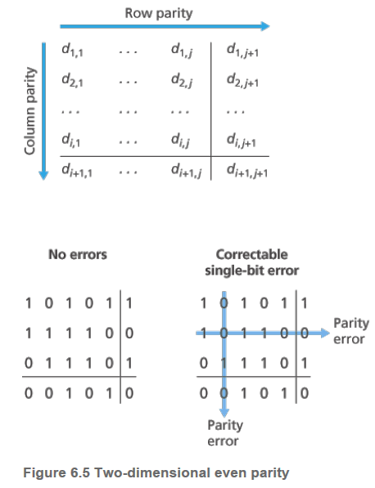
Parity checking
Single bit parity:
detect single bit errors
Two-dimensional bit parity:
detect and correct single bit errors
Number of 1s bits is even -> parity bit is 0
Number of 1s bits odd -> parity bit is 1
The two types of parity checking are
Even Parity
Odd Parity
https://www.tutorialspoint.com/what-is-a-parity-bit
* Check out the online interactive exercises for more examples: http://gaia.cs.umass.edu/kurose_ross/interactive/

Slide 23
Internet checksum (1)
Goal: detect “errors” (i.e., flipped bits) in transmitted packet (Note: used at transport layer only)
Sender:
treat segment contents as sequence of 16-bit integers
checksum: addition (1’s complement sum) of segment contents
sender puts checksum value into UDP checksum field
Receiver:
compute checksum of received segment
check if computed checksum equals checksum field value:
NO - error detected
YES - no error detected. But maybe errors nonetheless?

Slide 24
Internet checksum (2)
Transmitter
Receiver
Step1: Now, all the segments are added and the result is obtained as:
10011001 + 11100010 + 00100100 + 10000100 = 1000100011
Step 2: Since the result consists of 10 bits, so extra 2 bits are wrapped around.
00100011 + 10 = 00100101 (8 bits)
Step3: 1’s complement is taken which is 11011010.
Thus, Checksum value = 11011010
Transmit Data + Checksum
Sum of all segments (wrapped around) + Checksum value
= 00100101 + 11011010 = 11111111
No errors

Slide 25
Exercise
Computer networks, Chapter 3, p. 253
Exercise 15

Slide 26
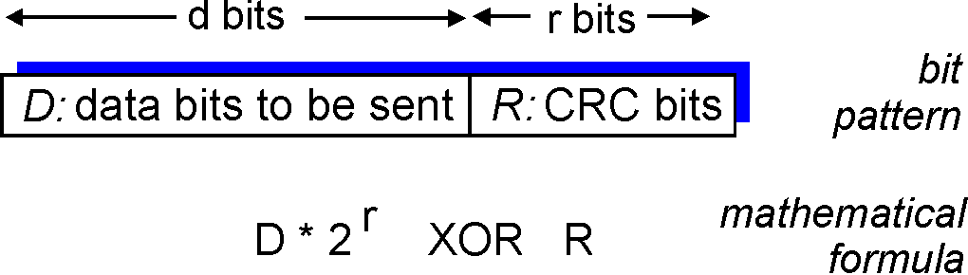
Cyclic redundancy check (CRC)
more powerful error-detection coding
view data bits, D, as a binary number
Let r be the degree of (generator), G
e.g. G(x) = x³ + 1 = 1.x³ + 0.x² + 0.x¹ + 1.x⁰ => G = 1001, r = 3
Goal: choose r CRC bits, R, such that
<D,R> exactly divisible by G (modulo 2)
receiver knows G, divides <D,R> by G. If non-zero remainder: error detected!
can detect all burst errors less than r bits
widely used in practice (Ethernet, 802.11 WiFi, ATM)

Slide 27
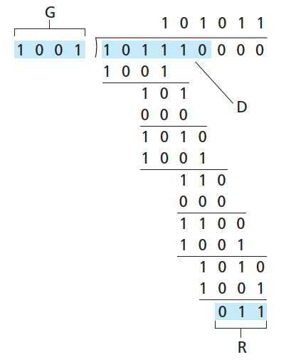
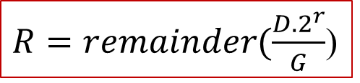
CRC example
want:
D.2^{r} XOR R = nG
equivalently:
D.2^{r} = nG XOR R
equivalently:
if we divide D.2^{r} by G, want remainder R to satisfy:
r bits
$R=remainder(\frac{D.2^{r}}{G}$)
Transmit
1 0 1 1 1 0 0 1 1
* Check out the online interactive exercises for more examples: http://gaia.cs.umass.edu/kurose_ross/interactive/

Slide 28
CRC example
At the receiver
G
Receive
1 0 1 1 1 0 0 1 1
1 0 0 1
1 0 0 1
1 0 1 0 1 1
1 0 1
0 0 0
1 0 1 0
1 0 0 1
1 1 0
0 0 0
1 1 0 1
1 0 0 1
1 0 0 1
1 0 0 1
0 0 0 0

Slide 29
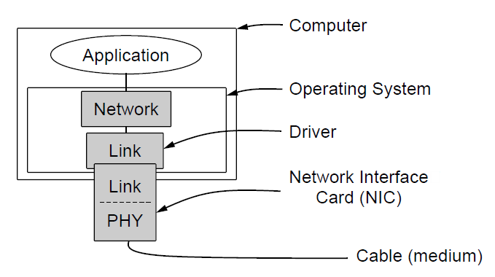
Elementary Data Link Protocols (2)
Implementation of the physical, data link, and network layers.

Slide 30
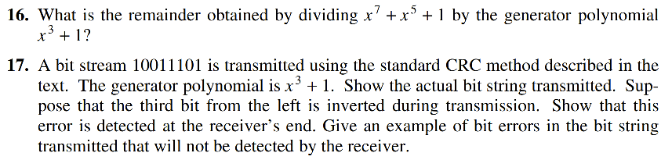
Exercise
Computer Networks, Chapter 3, p. 253
Exercise 16, 17

Slide 31
Link layer, LANs: outline
6.1 introduction, services
6.2 framing
6.3 error detection, correction
6.4 elementary data link protocols

Slide 32
Elementary Data Link Protocols (1)
Utopian Simplex Protocol
Simplex Stop-and-Wait Protocol
Error-Free Channel
Simplex Stop-and-Wait Protocol
Noisy Channel
Sliding Window Protocol
Go-back-N
Selective repeat

Slide 33
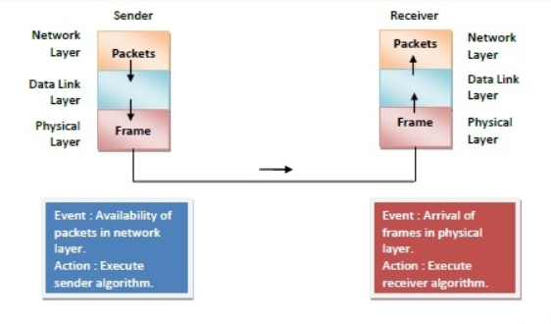
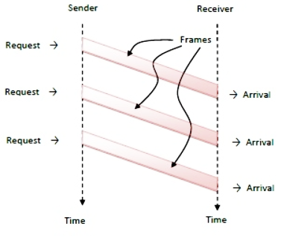
Utopian Simplex Protocol (1)
It is hypothetical protocol designed for unidirectional data transmission over an ideal channel, i.e. a channel through which transmission can never go wrong. Since this protocol is totally unrealistic, it is often called Utopian Simplex protocol.
Example Utopian protocol written in C

Slide 34
Simplex Stop-and-Wait Protocol for a Noisy Channel (1)
Simplex Stop – and – Wait protocol for noisy channel is data link layer protocol for data communications with error control and flow control mechanisms.
It is popularly known as Stop – and –Wait Automatic Repeat Request (Stop – and – Wait ARQ) protocol. It adds error control facilities to Stop – and – Wait protocol.

Slide 35
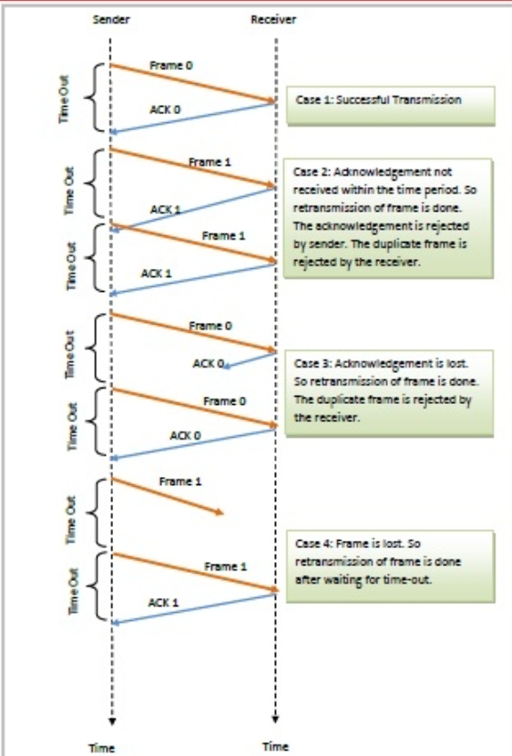
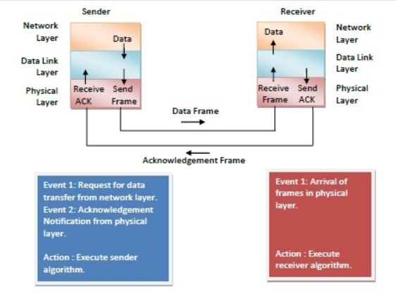
Simplex Stop-and-Wait Protocol for a Noisy Channel (2)
Example Stop and Wait protocol written in C

Slide 36
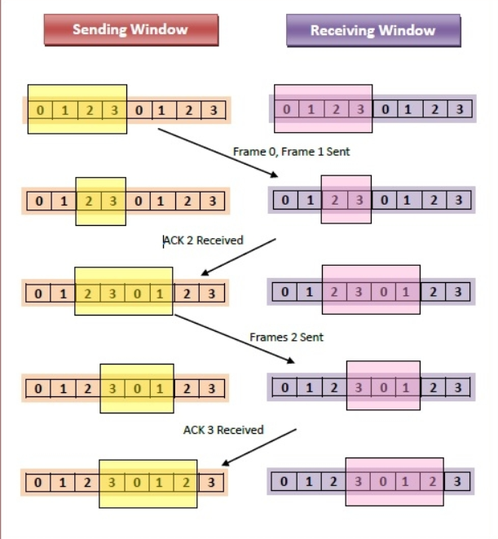
Sliding Window Protocols (1)
In this protocol, multiple frames can be sent by a sender at a time before receiving an acknowledgment from the receiver. The term sliding window refers to the imaginary boxes to hold frames.
the sender has a buffer called the sending window and the receiver has buffer called the receiving window.
two categories
Go – Back – N ARQ
Selective Repeat ARQ

Slide 37
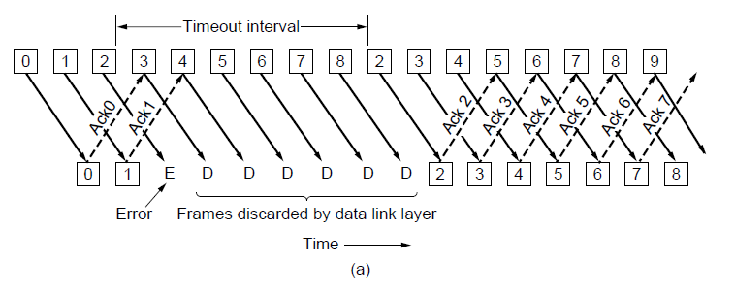
Protocol Using Go-Back-N (1)
Pipelining and error recovery. Effect of an error when
(a) receiver’s window size is 1

Slide 38
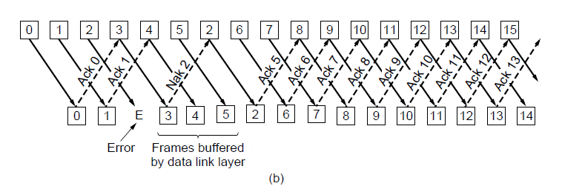
Protocol Using Go-Back-N (2)
Pipelining and error recovery. Effect of an error when
(b) receiver’s window size is large.

Slide 39
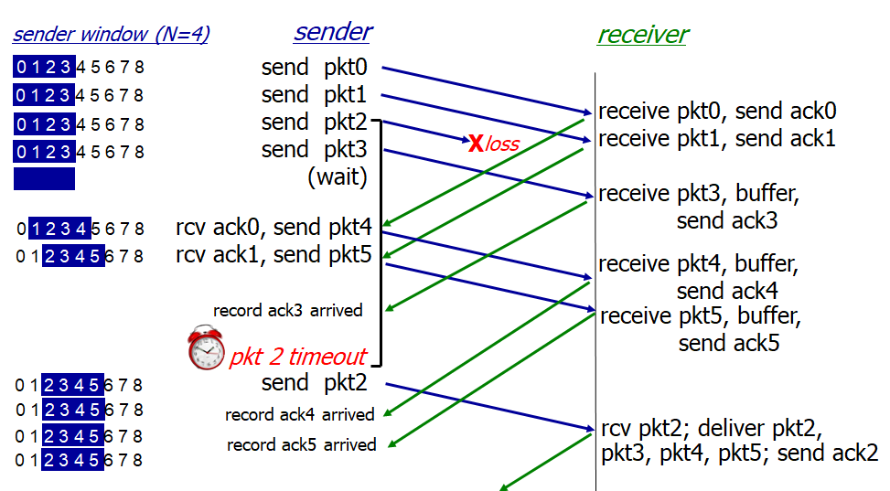
Protocol Using Selective Repeat (1)
This protocol also provides for sending multiple frames before receiving the acknowledgment for the first frame. However, here only the erroneous or lost frames are retransmitted, while the good frames are received and buffered.

Slide 40
Example Data Link Protocols
HDLC – High-Level Data Link Control
The Data Link Layer in the Internet

Slide 41
HDLC – High-Level Data Link Control
HDLC is a group of data link (Layer 2) protocols used to transmit synchronous data packets between point-to-point nodes (RFC 1662).
HDLC uses a zero-insertion/deletion process (bit stuffing) to ensure that the bit pattern of the delimiter flag does not occur in the fields between flags.

Slide 42
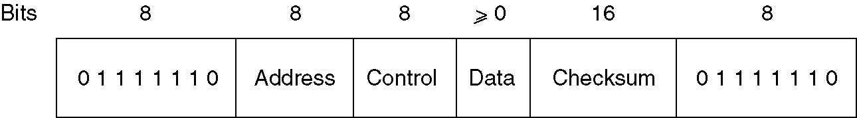
HDLC – High-Level Data Link Control
Frame format for bit-oriented protocols.
Data is usually sent in multiples of 8 bits, but only some variants require this; others theoretically permit data alignments on other than 8-bit boundaries.
The frame check sequence (FCS) is a 16-bit CRC or a 32-bit CRC computed over the Address, Control, and Information fields.

Slide 43
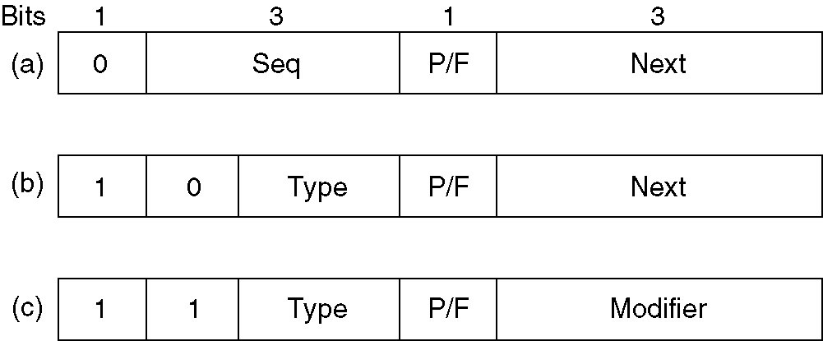
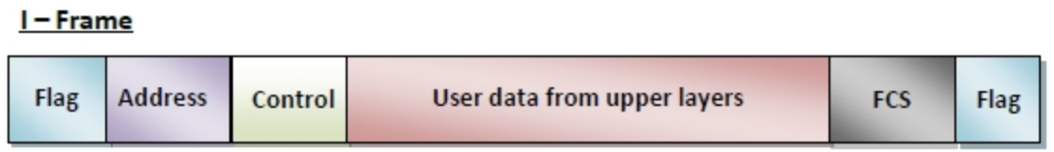
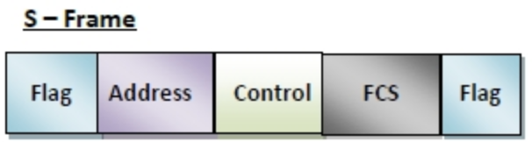
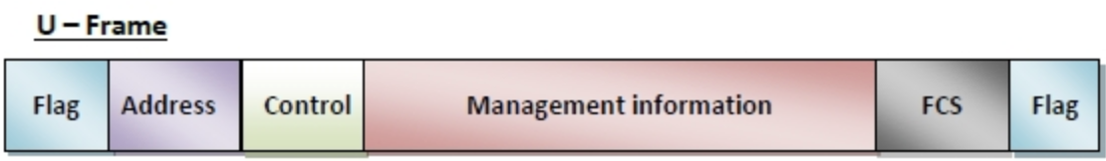
HDLC – High-Level Data Link Control
Control field:
(a) An information frame.
(b) A supervisory frame.
(c) An unnumbered frame.
https://www.tutorialspoint.com/high-level-data-link-control-hdlc

Slide 44
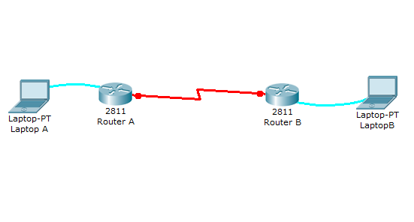
Practice
Packet Tracer
Generate a HDLC between 2 router A and B over a serial link.
192.168.2.1/24
192.168.10.1/30
192.168.10.2/30
192.168.1.1/24
192.168.2.2/24
192.168.1.2/24
//////////////////////////
Router-A(config)#interface serial 0/0/0
Router-A(config-if)#encapsulation hdlc
Router-A(config-if)#ip address 192.168.10.1 255.255.255.252
Router-A(config-if)#no shutdown
Serial link
Clock: 2500000 Hz
Router-B(config)#interface serial 0/0/0
Router-B(config-if)#clock rate 250000
//////////////////////////
Router-B(config)#interface serial 0/0/0
Router-B(config-if)#encapsulation hdlc
Router-B(config-if)#ip address 192.168.10.2 255.255.255.252
Router-B(config-if)#no shutdown
Router-B#ping 192.168.10.1
Type escape sequence to abort.
Sending 5, 100-byte ICMP Echos to 192.168.10.5, timeout is 2 seconds:
!!!!! Success rate is 100 percent (5/5), round-trip min/avg/max = 3/3/4 ms

Slide 45
Summary
Principles of data link layer services:
Framing
Byte count.
Flag bytes with byte stuffing.
Flag bytes with bit stuffing.
Error detection and correction
Parity check
Internet checksum
CRC
Elementary data link protocols
Utopian Simplex Protocol
Simplex Stop-and-Wait Protocol
Noisy Channel
Sliding window Protocol
Go-back-N
Selective Repeat

Slide 46
Appendix (not in exams)

Slide 47
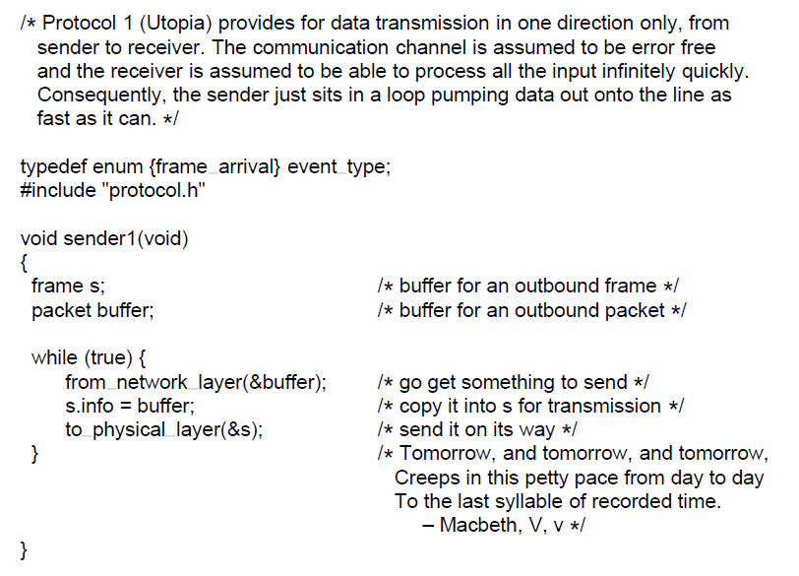
Utopian Simplex Protocol (2)
. . .
A utopian simplex protocol.

Slide 48
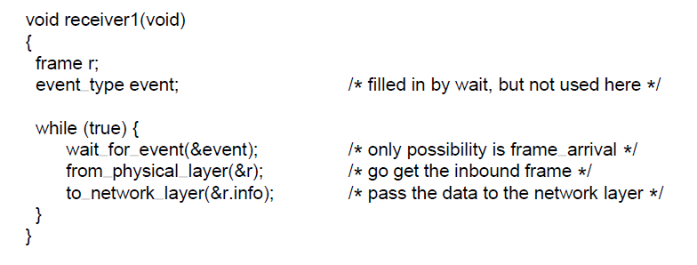
Utopian Simplex Protocol (3)
A utopian simplex protocol.
Go back to Utopian protocol

Slide 49
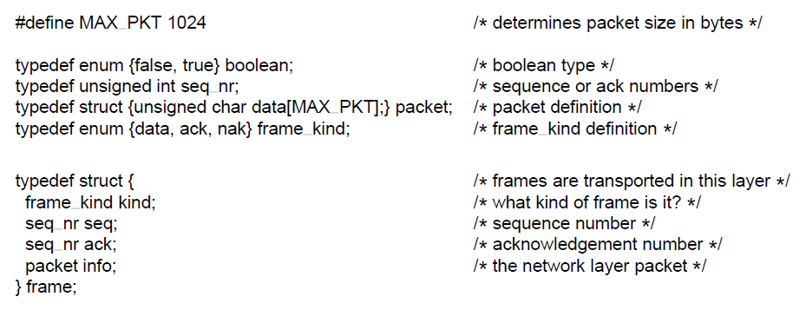
Elementary Data Link Protocols (3)
Some definitions needed in the protocols to follow. These definitions are located in the file protocol.h.
. . .

Slide 50
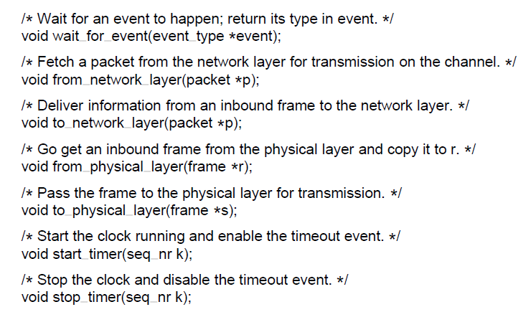
Elementary Data Link Protocols (4)
Some definitions needed in the protocols to follow. These definitions are located in the file protocol.h.
. . .

Slide 51
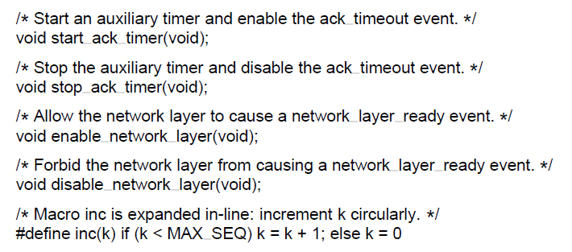
Elementary Data Link Protocols (5)
Some definitions needed in the protocols to follow. These definitions are located in the file protocol.h.

Slide 52
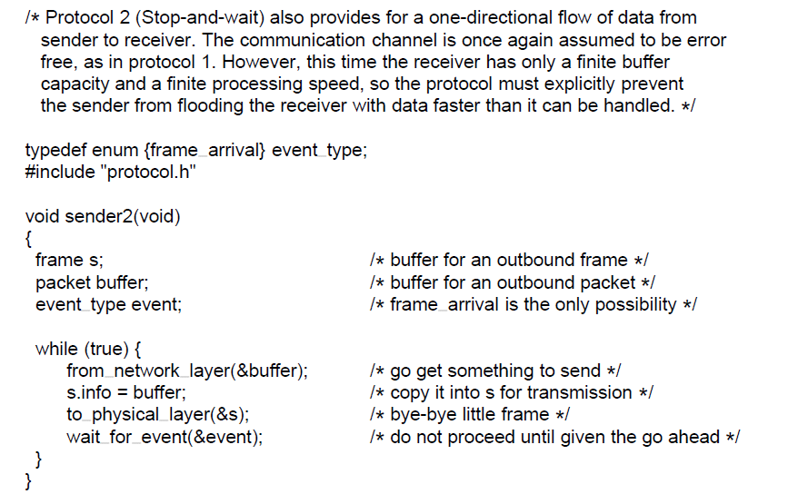
Simplex Stop-and-Wait Protocol for a Noisy Channel (3)
. . .
A simplex stop-and-wait protocol.

Slide 53
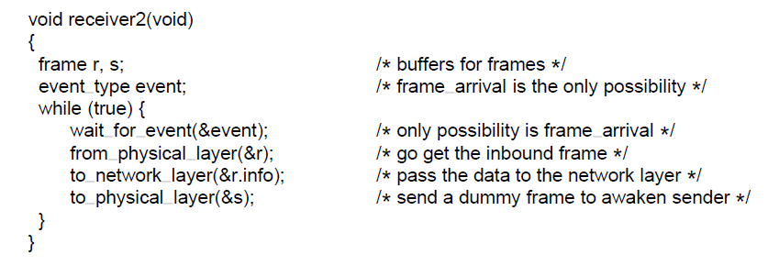
Simplex Stop-and-Wait Protocol for a Noisy Channel (4)
A simplex Stop-and-Wait protocol.
Go back to Stop and Wait protocol

Slide 54
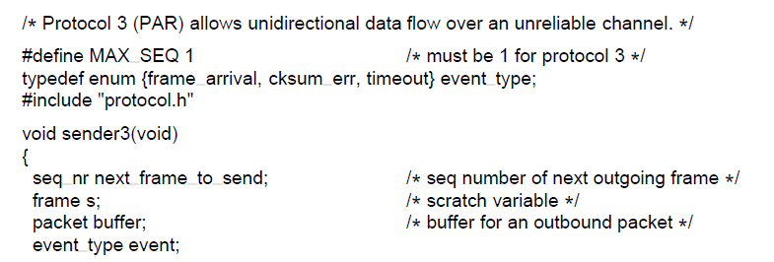
Sliding Window Protocols (2)
A positive acknowledgement with retransmission protocol.
. . .

Slide 55
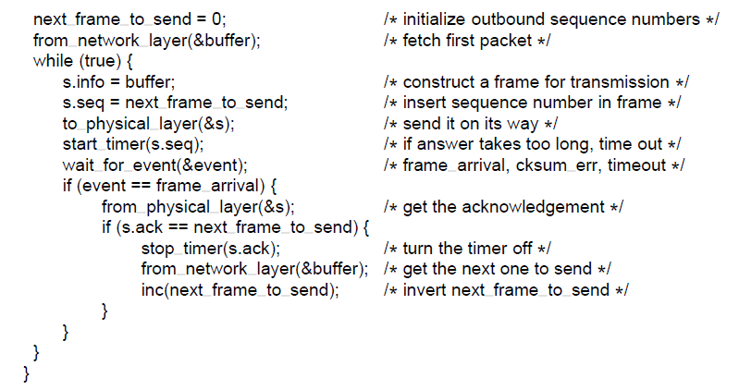
Sliding Window Protocols (2)
A positive acknowledgement with retransmission protocol.
. . .

Slide 56
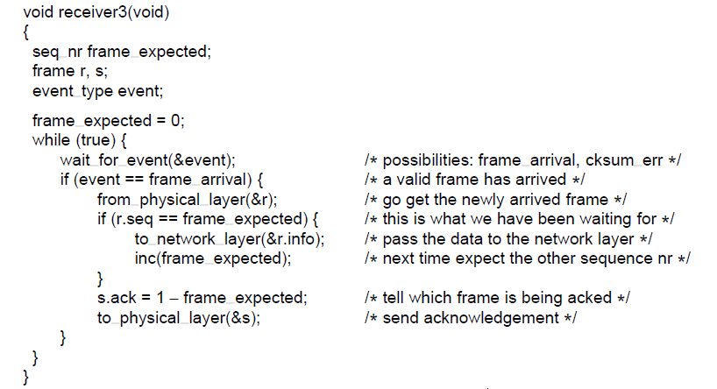
Sliding Window Protocols (4)
A positive acknowledgement with retransmission protocol.

Slide 57
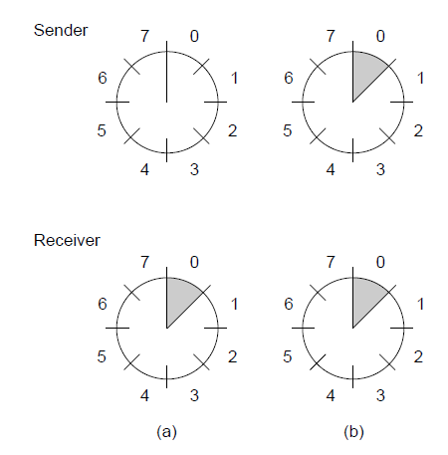
Sliding Window Protocols (5)
A sliding window of size 1, with a 3-bit sequence number. (a) Initially. (b) After the first frame has been sent.

Slide 58
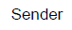
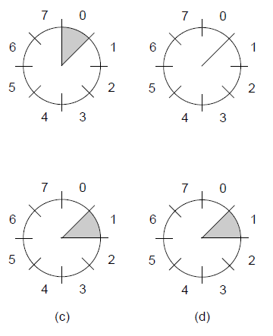
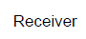
Sliding Window Protocols (6)
A sliding window of size 1, with a 3-bit sequence number
(c) After the first frame has been received. (d) After the first acknowledgement has been received.

Slide 59

One-Bit Sliding Window Protocol (1)
. . .
A 1-bit sliding window protocol.

Slide 60

One-Bit Sliding Window Protocol (2)
. . .
A 1-bit sliding window protocol.

Slide 61

One-Bit Sliding Window Protocol (3)
A 1-bit sliding window protocol.

Slide 62

One-Bit Sliding Window Protocol (4)
Two scenarios for protocol 4. (a) Normal case. (b) Abnormal
case. The notation is (seq, ack, packet number). An asterisk indicates where a network layer accepts a packet

Slide 63

Protocol Using Go-Back-N (3)
A sliding window protocol using go-back-n.
. . .

Slide 64

Protocol Using Go-Back-N (4)
A sliding window protocol using go-back-n.
. . .

Slide 65

Protocol Using Go-Back-N (5)
A sliding window protocol using go-back-n.
. . .

Slide 66

Protocol Using Go-Back-N (6)
A sliding window protocol using go-back-n.
. . .

Slide 67

Protocol Using Go-Back-N (7)
A sliding window protocol using go-back-n.
. . .

Slide 68

Protocol Using Go-Back-N (8)
A sliding window protocol using go-back-n.
. . .

Slide 69

Protocol Using Go-Back-N (9)
A sliding window protocol using go-back-n.

Slide 70

Protocol Using Go-Back-N (10)
Simulation of multiple timers in software. (a) The queued timeouts (b) The situation after the first timeout has expired.

Slide 71

Protocol Using Selective Repeat (2)
A sliding window protocol using selective repeat.
. . .

Slide 72

Protocol Using Selective Repeat (3)
A sliding window protocol using selective repeat.
. . .

Slide 73

Protocol Using Selective Repeat (4)
A sliding window protocol using selective repeat.
. . .

Slide 74

Protocol Using Selective Repeat (5)
A sliding window protocol using selective repeat.
. . .

Slide 75

Protocol Using Selective Repeat (6)
A sliding window protocol using selective repeat.
. . .

Slide 76

Protocol Using Selective Repeat (7)
A sliding window protocol using selective repeat.
. . .

Slide 77

Protocol Using Selective Repeat (7)
A sliding window protocol using selective repeat.
. . .

Slide 78

Protocol Using Selective Repeat (8)
A sliding window protocol using selective repeat.
. . .

Slide 79

Protocol Using Selective Repeat (9)
A sliding window protocol using selective repeat.

Slide 80

Protocol Using Selective Repeat (10)
Initial situation with a window of size 7
After 7 frames sent and received but not acknowledged.
Initial situation with a window size of 4.
After 4 frames sent and received but not acknowledged.

